Slide 1
Introducing Deprescribing to Singapore
Brought to you by Pharmaceutical Society of Singapore (PSS) as part of Pharmacy Week 2016

Slide 2
Case Study
- LYL, Female 71 years old
Before:
1) Gabapentin 300mg TDS
2) Insulin Aspart Flex Pen 14 units BD
3) Metformin 850mg TDS
4) Atenolol 50mg OM
5) Amlodipine 10mg OM
6) Enalapril 10mg BD
7) Aspirin 100mg OM
8) Omeprazole 40mg BD
9) Simvastatin 20mg ON
10) Calcium Vit D 1 OM
11) Glargine 56 units ON
12) Diclofenac 50mg TDS PRN
13) Neuroforte 1 OM
PMHx: HTN, DM, HLD, depression and cervical spondylosis.
(Taking BD)
(Disturbing Cough)
(Taking 20mg BD)
TOO MANY MEDICINES!
TAKEN WRONGLY

Slide 3
Overview
Polypharmacy
Introduction to Deprescribing
How to Deprescribe
Proton Pump Inhibitors
Conclusion

Slide 4
Prevalence of Polypharmacy in Singapore
At least 50% of discharged patients from a local hospital had > 5 chronic medications¹
Among 454 geriatric nursing home residents, 70% had inappropriate medication use ²
1. In-hospital data for discharges (Jan 2013 – Dec 2014), a Singapore restructured hospital.
2. Ann Acad Med Singapore. 2004 Jan: 33(1): 49-52.

Slide 5
Consequences of Polypharmacy
Increased
Risk of adverse drug events
Non-compliance due to complex drug regimen and pill burden
Unnecessary expenditure
Risk of drug-drug interactions
Hospitalizations
Risk of falls and fractures in the elderly
Clin Geriatr Med 2012;28:173-86

Slide 6
What can we do to reduce polypharmacy and its adverse patient outcomes?

Slide 7
Deprescribing
Systematic process of identifying and discontinuing drugs in which the harms outweigh existing or potential benefits of an individual patient’s care goals, current level of functioning, life expectancy, values, and preferences.
Part of the prescribing continuum
JAMA Intern Med 2015;175:827-34

Slide 8
Benefits of Deprescribing
Improved compliance
Improved quality of life
Reduced risk of adverse drug events
Reduced risk of drug-drug interactions
Reduced healthcare costs
JAMA Intern Med 2015;175:827-34

Slide 9
Barriers to Deprescribing
Fear of condition worsening
Concerns about withdrawal effects from drug cessation
Fragmented care among multiple specialists
Drugs and Aging 2013; 30(10): 793-807.

Slide 10
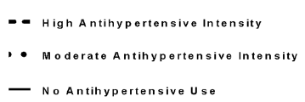
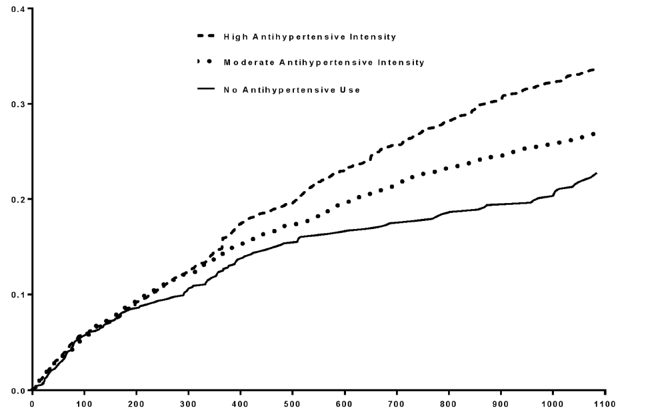
Over-prescribing Can Harm
Cumulative incidence of cardiovascular events
N=4961 , Median age 80 years receiving
anti-hypertensives
Days since baseline
PLoS ONE. 2014;9(3):e90733.

Slide 11
Medication withdrawal is safe
2013
Chronic antipsychotics were withdrawn without behavioural decline in people with dementia, especially when symptoms have largely resolved
Exceptions are patients with more severe neuropsychiatric symptoms at baseline and psychosis/agitation that previously responded well to antipsychotics
Cochrane Database Syst Rev. 2013 Mar 28;3:CD007726
Notes:
11

Slide 12
How to deprescribe

Slide 13
5-Step Deprescribing Process
JAMA Intern Med. 2015;175(5):827-34.

Slide 14
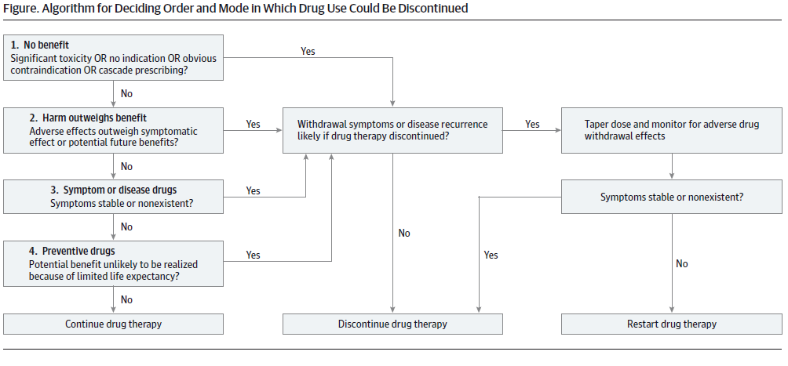
Deprescribing Algorithm
JAMA Intern Med. 2015;175(5):827-834.

Slide 15
Deprescribing in Action
Ongoing development of deprescribing guidelines in Australia and Canada for proton pump inhibitors (PPI) & benzodiazepines
Singapore – starting with PPI

Slide 16
Overall Usage and Cost of PPIs in 2014
Data collected from 8 institutions in Singapore
DRUG | Total USAGE in 2014 | Average cost per tab | Total COST to Patient in 2014
Omeprazole 20mg | 57,769,448 | $0.24 | $13,864,668
Lansoprazole 30mg | 135,466 | $2.29 | $310,217
Esomeprazole 20mg | 413,764 | $4.85 | $2,006,756
Esomeprazole 40mg | 666,171 | $4.85 | $3,230,929
Rabeprazole 10mg | 8,400 | $1.40 | $11,760
Rabeprazole 20mg | 71,500 | $1.40 | $100,100
Pantoprazole 40mg | 18,959 | $2.94 | $55,740
TOTAL | 59,083,708 | - | $19,580,170
Over 59 million capsules
Over 19 million dollars!!!

Slide 17
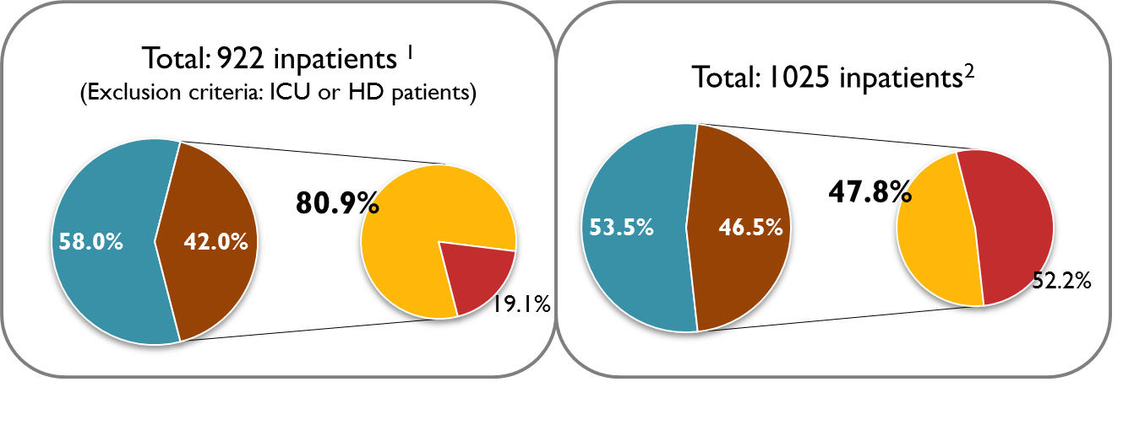
PPI Use in Singapore
patients on PPI
patients not on PPI
patients with inappropriate indications for PPI
patients with appropriate indications for PPI
1. In-hospital data (Oct 2014), National University Hospital.
2. In-hospital data (June 2011), Tan Tock Seng Hospital.

Slide 18
Appropriate PPI Indications
Gastro-esophageal reflux disease (GERD)
Peptic ulcer disease (PUD)
Helicobacter pylori eradication
Zollinger-Ellison Syndrome
Uninvestigated dyspepsia
PPI approved indications. http://www.cms.gov/Medicare-Medicaid-Coordination/Fraud-Prevention/Medicaid-Integrity-Education/Pharmacy-Education-Materials/Downloads/ppi-adult-dosingchart.pdf. Accessed August 15, 2015.

Slide 19
Appropriate PPI Indications
Prevention of NSAID-induced ulcers with risk factors¹
Age > 65 years
History of PUD or gastrointestinal (GI) bleed
Concurrent use of low dose aspirin, antiplatelets, anticoagulants or steroids
Prevention of GI bleed for patients on dual antiplatelet therapy with risk factors²
Am J Gastroenterol 2009;104(3):728-38.
Am J Gastroenterol 2010;105(12):2533-49.

Slide 20
PPI usage with NSAIDs
Patients with high GI risk (e.g. history of complicated ulcer or > 2 GI risk factors) should avoid NSAIDs¹
Patients with low GI risk should not receive PPI for GI prophylaxis with NSAIDs¹
No RCTs has evaluated efficacy of PPI in preventing complications (e.g bleeding, perforation, death) from NSAIDs-induced ulcers¹
(NSAIDs + PPI) vs COX-2 inhibitors had similar symptomatic ulcer recurrence rates in high risk patients.²
1. Am J Gastroenterol 2009; 104:728–738;
2. Scheiman Arthritis Research & Therapy 2013, 15(Suppl 3):S5.

Slide 21
Recommendations for prevention of NSAID-related ulcer complications
 | Gastrointestinal riskª
 | Low | Moderate | High
Low CV risk | NSAID alone (the least ulcerogenic NSAID at the lowest effective dose) | NSAID + PPI/misoprostol | Alternative therapy if possible or COX-2 inhibitor + PPI/misoprostol
High CV risk^{b} (low-dose aspirin required) | Naproxen + PPI/misoprostol | Naproxen + PPI/misoprostol | Avoid NSAIDs or COX-2 inhibitors. User alternative therapy
ª Gastrointestinal risk is stratified into low (no risk factors), moderate (presence of one or two risk factors) and high (multiple risk factors, or previous ulcer complications, or concomitant use of corticosteroids or anticoagulants). ^{b} High CV risk is arbitrarily defined as the requirement for low-dose aspirin for prevention of serious CV events. All patients with a history of ulcers who require NSAIDs should be tested for H. pylori and if the infection is present, eradication therapy should be given.
1. Table adapted from : Am J Gastroenterol 2009;104:728 – 738
2. Lancet. 2007 May 12;369(9573):1621-6

Slide 22
Adverse Effects of Long Term PPI Use
1. Clostridium difficile infection
US FDA safety alert 2012: 1.4 to 2.75 times higher risk of C. difficile diarrhoea¹
Meta-analysis including 313,000 patients²
Increased risk of incident C. difficile infection (odds ratio [OR] 1.7; 95% CI 1.5-2.9 )
Increased risk of recurrent C. difficile infection (odds ratio [OR] 2.5; 95% CI 1.2-5.4)
http://www.fda.gov/Drugs/DrugSafety/ucm290510.htm [accessed June 13, 2015]
Am J Gastroenterol. 2012;107(7):1011.

Slide 23
Adverse Effects of Long Term PPI Use
2. Community acquired pneumonia
Meta-analysis: use of PPI increased risk of pneumonia (adjusted OR 1.27, 95% CI 1.11-1.46)
Higher doses of PPI more strongly associated with pneumonia (adjusted OR 1.52 vs 1.37)
CMAJ. 2011 Feb 22;183(3):310-9.

Slide 24
Adverse Effects of Long Term PPI Use
3. Fractures
Meta-analysis
Increased risk of any fracture (adjusted OR 1.30, 95% CI 1.15-1.48) and hip fracture (adjusted OR 1.34, 95% CI 1.09-1.66) with PPI use for longer than a year
Increased risk of hip fracture for both high dose (adjusted OR 1.53, 95% CI 1.18-1.97) and usual dose PPI (adjusted OR 1.42, 95% CI 1.31-1.53)
Ann Fam Med. 2011 May-Jun;9(3):257-67
Notes:
5 case-controls, 3 nested case-controls, 3 cohort studies

Slide 25
Adverse Effects of Long Term PPI Use
4. Hypomagnesemia
US FDA safety alert 2011¹:
Hypomagnesemia reported in patients taking PPIs after a year, ~25% of these cases required Mg supplementation and discontinuation of PPI
Cross-sectional analysis²:
Significant association between PPI use and hypomagnesemia risk after multivariable regression analyses
1. http://www.fda.gov/Drugs/DrugSafety/ucm245011.htm [accessed 13th June 2015]
2. Int J Clin Pract. 2014 Nov;68(11):1352-7

Slide 26
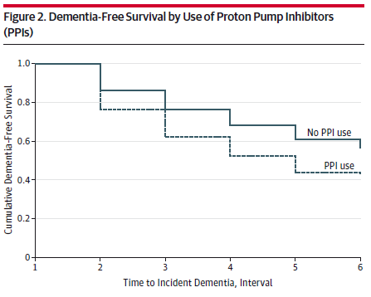
Adverse Effects of Long Term PPI Use
5. Dementia
German Pharmacoepidemiological Claims Data Analysis study:
N = 73679
75 years or older
Free of dementia at baseline
Regular PPI users had a significantly increased risk of incident dementia compared to non users (hazard ratio, 1.44; P < .001)
JAMA Neurol. 2016;73(4):410-41

Slide 27
Adverse Effects of Long Term PPI Use
6. Chronic Kidney Disease
Atherosclerosis Risk in Communities study
N=10, 482
Mean age = 63 years old
PPI use was associated with CKD (adjusted HR, 1.24; 95% CI, 1.20-1.28)
BD PPI dosing (adjusted HR, 1.46; 95% CI, 1.28-1.67) was associated with a higher risk than OD dosing (adjusted HR, 1.15; 95% CI, 1.09-1.21).
Lazarus B, Chen Y, Wilson FP, et al. Proton Pump Inhibitor Use and the Risk of Chronic Kidney Disease. JAMA Intern Med. 2016;176(2).

Slide 28
How to deprescribe ppi?

Slide 29
How to Deprescribe PPIs?
Ontario Group, PPI Deprescribing Algorithm, Sept 2015

Slide 30
How to Deprescribe PPIs?
STOP
DECREASE DOSE OR SWITCH TO PRN
CONTINUE
After 2-12 weeks of PUD treatment (NSAID, H. pylori)
H. pylori treated for 2 weeks and asymptomatic
ICU stress ulcer prophylaxis beyond ICU admission
No indication*
* If unsure, find out if there is a history of endoscopy, hospitalisation for bleeding ulcer, past chronic NSAID use or symptoms of heartburn or dyspepsia
Mild to moderate esophagitis
GERD treated for 4-8 weeks, esophagitis healed and symptoms controlled
Barrett’s oesophagus
Chronic NSAID users with bleeding risk
Severe esophagitis
Documented history of bleeding GI ulcer
* Consult gastroenterologist if considering deprescribing
Ontario Group, PPI Deprescribing Algorithm, Sept 2015

Slide 31
How to Deprescribe PPIs?
MONITORING
Monitor patients at 4 and 12 weeks after deprescribing
Signs and symptoms to look out for:
Heartburn
Regurgitation
Dyspepsia
Epigastric pain
Agitation
Weight loss
Ontario Group, PPI Deprescribing Algorithm, Sept 2015

Slide 32
Back to the case...
- LYL, Female 71 years old
Before:
1) Gabapentin 300mg TDS
2) Insulin Aspart Flex Pen 14 units BD
3) Metformin 850mg TDS
4) Atenolol 50mg OM
5) Amlodipine 10mg OM
6) Enalapril 10mg BD
7) Aspirin 100mg OM
8) Omeprazole 40mg BD
9) Simvastatin 20mg ON
10) Calcium Vit D 1 OM
11) Glargine 56 units ON
12) Diclofenac 50mg TDS PRN
13) Neuroforte 1 OM
PMHx: HTN, DM, HLD, depression and cervical spondylosis.
(Taking BD instead)
(Disturbing Cough)
(Taking 20mg BD)
TOO MANY MEDICINES!
TAKEN WRONGLY

Slide 33
Case Study
No | BEFORE | AFTER
1 | Gabapentin 300mg TDS | Gabapentin 300mg TDS
2 | Insulin Aspart 14 u BD | Insulin Aspart 14 u BD
3 | Metformin 850mg TDS | Metformin 850mg TDS
4 | Atenolol 50mg OM | Atenolol 50mg OM
5 | Amlodipine 10mg OM | Amlodipine 10mg OM
6 | Enalapril 10mg BD | Irbesartan 150mg BD
7 | Aspirin 100mg OM | Aspirin 100mg OM
8 | Glargine 56u ON | Glargine 56u ON
9 | Simvastatin 20mg ON | Simvastatin 20mg ON
10 | Calcium Vit D 1 OM | Removed
11 | Omeprazole 40mg BD | Removed
12 | Diclofenac 50mg TDS PRN | Removed
13 | Neuroforte 1 OM | Removed
Total Daily Doses | 22 | 15
Pill burden | 21 (excluding insulin) | 12

Slide 34
Conclusion
Polypharmacy can potentially lead to adverse drug events and hospital readmissions
Deprescribing is part of the prescribing continuum
Deprescribing can minimize polypharmacy
PPI is a drug class with great deprescribing potential
Doctors and pharmacists can promote medication safety and patient well-being

Slide 35
Thank You!
*Slides were adapted from Deprescribing kit 2015
Pharmacy Week 2015
IPE 2015 Committee:
Grant Sklar, NUS
Soong Jie Lin, SGH
Chuang Shen Hui, TTSH
Kelvin Xu, KKH
Loke Ek Theng, Mt. Alvernia
Chee Enqing, SGH
Dennis Chua, NTFGH
Veronica Teo, NTFGH
Koh Tsing Yi, NUH
Chairperson: Doreen Tan
Pharmacy Week 2016
IPE Committee:
Goh Hui Fen Jessica, KTPH
Chee Enqing, SGH
Marvin Sim, NHGP
Michelle Tan, TTSH
Karmen Quek , CGH
Vidhya Segar, KTPH
Gavin Loo, NUH
Chairperson: Grace Chew, Soong Jie Lin

